Slide 1
ចំណេះដឹង
Knowledge
ជំនាញ
Skills
ឧត្ដមភាព
Excellence
សង្គម
Social

Slide 2


កិច្ចការស្រាវជ្រាវ
www.usea.edu.kh
Student Attendance Analytics System
Turning attendance data into early warnings and better decisions
មុខវិជ្ជា៖
[Course name / code]
ប្រធានបទ៖
Student Attendance Analytics System
បង្រៀនដោយ៖
[Lecturer name]
ស្រាវជ្រាវដោយក្រុមនិស្សិត៖
[Team member names]
កាលបរិច្ឆេទ៖
[Presentation date]
Knowledge. Skills .Excellence . Social
បទបង្ហាញដោយ៖ [Team member names]
Notes:
Introduce the team. One sentence: this is not just a system that records who is present; it turns attendance data into early warnings, so the school can see who needs help first and check whether its actions worked.

Slide 3
មាតិកា
www.usea.edu.kh
          ១. សេចក្តីផ្តើម — Introduction
          ២. រំលឹកទ្រឹស្តី — Analytics & Design
          ៣. លទ្ធផលស្រាវជ្រាវ — Results
          ៤. សេចក្តីសន្និដ្ឋាន — Conclusion
          ៥. DEMO
Knowledge. Skills .Excellence . Social
បទបង្ហាញដោយ៖ [Team member names]

Slide 4
១. សេចក្តីផ្តើម
www.usea.edu.kh
១.១ The Problem
A rate alone hides the trend: two students at 90% can be very different
1
THE CORE PROBLEM
Problems are found too late: 95% → 90% → 82% → 68% before anyone reacts
Schools collect attendance data, but it is not turned into insight.
2
Patterns stay hidden: which day, period or subject has the most absences?
3
Schools act, but rarely check whether the action worked
4
Slow paper records are only the first step, not the main problem.
Parents hear about absences late, or not at all
5
Knowledge. Skills .Excellence . Social
បទបង្ហាញដោយ៖ [Team member names]
Notes:
Problem statement: high schools collect a lot of attendance data, but they lack a way to turn it into clear information about patterns, declining trends, at-risk students and the effect of their actions. So problems are found late, and decisions are not always based on evidence.

Slide 5
១. សេចក្តីផ្តើម
www.usea.edu.kh
១.២ Why a Rate Alone Is Not Enough
Week | Student A | Student B
Week 1 | 100% | 90%
Week 2 | 100% | 90%
Week 3 | 100% | 90%
Week 4 | 80% | 90%
Week 5 | 70% | 90%
Average | 90% | 90%
What our system says instead
"Student A: 70%, down 20 points in 2 weeks. High risk."
"Dara is often absent on Wednesday, Period 1, in Mathematics, and it is getting worse."
"11B is down 6.2 points; Physics is the lowest subject."
Same average, very different stories. Student A needs help now.
Every number comes with its trend and its meaning, so the school knows what to do next.
Knowledge. Skills .Excellence . Social
បទបង្ហាញដោយ៖ [Team member names]
Notes:
The usual formula is Present divided by all records. But the average hides the direction. Our system compares the last 4 weeks with the 4 weeks before, and writes the result in plain words.

Slide 6
១. សេចក្តីផ្តើម
www.usea.edu.kh
១.៣ Our Solution
1 Collect
2 Analyze
3 Warn
4 Act
5 Measure
APP
Android app
WEB
Website
for teachers
for admins (and teachers)
Collect data and act at once: mark attendance, add a reason, notify parents, get alerts.
Analyze and decide: insights, risk list, interventions, reports. Teachers see only their own classes.
1
Fast, complete data
2
Early warning
Everyone starts as Present; tap only the absent students
Trends, risk levels and alerts for absences in a row
3
Measured action
4
English and Khmer
Attendance before and after each follow-up
Light and dark mode, on phone and computer
Knowledge. Skills .Excellence . Social
បទបង្ហាញដោយ៖ [Team member names]
Notes:
The system does not stop at "save attendance". Teachers collect complete data on the app; the website turns it into patterns, risk levels and alerts; the school acts, and the system measures whether attendance changed. Android = data collection and immediate action. Website = analytics and decision support.

Slide 7
១. សេចក្តីផ្តើម
www.usea.edu.kh
១.៤ Project Objectives
01
02
03
Record complete attendance for a class in under a minute
Show every attendance rate together with its trend
Detect at-risk students early, with clear risk levels
04
05
Find where and when problems happen: day, period, subject
Record what the school did, and measure attendance before and after
Knowledge. Skills .Excellence . Social
បទបង្ហាញដោយ៖ [Team member names]

Slide 8
១. សេចក្តីផ្តើម
www.usea.edu.kh
១.៥ User Roles (2 Roles)
 | Admin | Teacher
Platform | Website | Android app and website
Purpose | Manage the school and its analytics | Record attendance and follow up own students
Main actions | School data; insights, risk list, interventions; approve corrections; reports; audit log | Mark attendance with an optional reason; alerts; notify parents; record follow-ups; own history and analytics
Corrections | Any time, with a reason, always logged | Own records within 24 hours; after that, send a request
Sees | The whole school | Assigned classes only
No Student or Parent login. Students are records; parents are contacts who receive Telegram or SMS messages. The principal uses an Admin account.
Knowledge. Skills .Excellence . Social
បទបង្ហាញដោយ៖ [Team member names]
Notes:
Two roles keep the scope focused and the security simple. The backend checks permissions on every request, so a teacher can only see and change their assigned classes.

Slide 9
២. រំលឹកទ្រឹស្តី
www.usea.edu.kh
២.១ Five Layers of Analytics
Layer | Question | In our system
1. Descriptive | What happened? | Rate and absences by student, class, grade, subject and month
2. Diagnostic | Where and when? | Lowest day, period and subject; day × period hotspots; absence reasons
3. Early warning | Who is at risk? | Risk levels, alerts for 3 days in a row, falling trends
4. Suggested action | What could we do? | A suggested follow-up for each risk level
5. Intervention result | Did it help? | Attendance before vs. after each action
We say "Early Warning", not "prediction": we do not claim to predict dropouts. The system supports decisions; people decide.
Knowledge. Skills .Excellence . Social
បទបង្ហាញដោយ៖ [Team member names]
Notes:
This is what makes it an analytics system and not just a recording system. Each layer answers a different question, from what happened to whether our action helped.

Slide 10
២. រំលឹកទ្រឹស្តី
www.usea.edu.kh
២.២ Tools & Technology
1
2
3
Figma + Figma Make
HTML + Tailwind CSS 4 + daisyUI 5
ApexCharts + Lucide
Design and the Android prototype (React 19 + TypeScript + Tailwind CSS 4)
All pages of the website, for admins and teachers
Charts, hotspot grid and icons on the website
4
5
6
One translation file
Laravel REST API (next)
PostgreSQL (next)
English and Khmer on every page, including charts
One shared backend for the website and the Android app
One database with integrity rules, triggers and an audit log
Target platforms: web browsers (admins and teachers) and Android (teachers). Android app in [e.g. Kotlin / Jetpack Compose].
Knowledge. Skills .Excellence . Social
បទបង្ហាញដោយ៖ [Team member names]

Slide 11
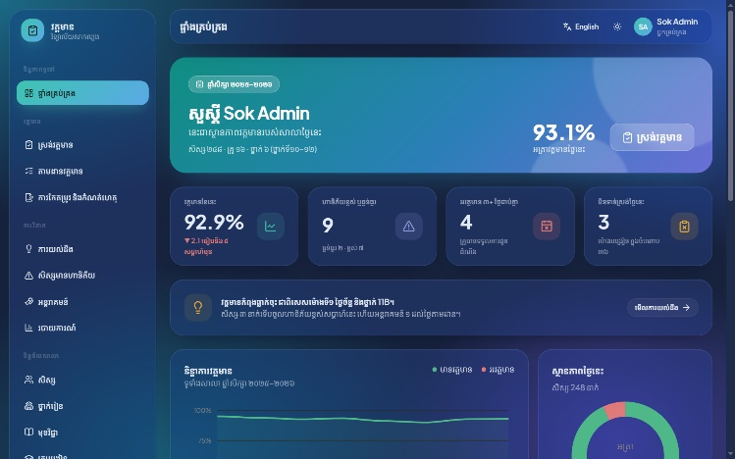
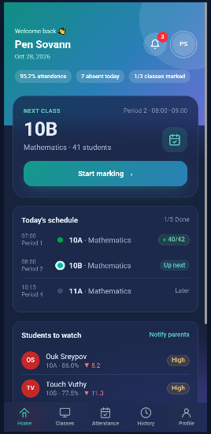
២. រំលឹកទ្រឹស្តី
www.usea.edu.kh
២.៣ Design System
 | Android app | Website
Built with | React prototype (Figma Make) | Tailwind CSS 4 + daisyUI 5
Fonts | Roboto + Kantumruy Pro | Plus Jakarta Sans + Kantumruy Pro
Look | Teal, soft glass cards | Teal, soft glass cards
Themes | Light and dark | Light and dark
Website: Khmer + dark mode
Shared on both platforms
Green = Present, Red = Absent, always with an icon and a label
The same numbers and the same sample school
Readable contrast, large touch targets, Khmer font
App: dark mode
Knowledge. Skills .Excellence . Social
បទបង្ហាញដោយ៖ [Team member names]
Notes:
The app and the website now share one look: teal, soft glass cards, and the same gradient. Both have light and dark mode, and both switch to Khmer.

Slide 12
២. រំលឹកទ្រឹស្តី
www.usea.edu.kh
២.៤ Key Rule: Only Two Statuses
✓
Present
✗
Absent
Counts toward the rate
Optional reason: Sick, Family, School activity, Other, Not given
No Late, Excused, Leave or Pending status
The reason is extra information for analysis; the status stays Present or Absent
Always shown with a label and an icon, never color alone (accessibility)
Attendance rate = Present ÷ all submitted records
Knowledge. Skills .Excellence . Social
បទបង្ហាញដោយ៖ [Team member names]
Notes:
Two statuses keep marking fast and the rate easy to explain. The optional reason lets the school see the difference between 8 sick days and 8 absences with no reason. Draft sessions are never counted.

Slide 13
៣. លទ្ធផលស្រាវជ្រាវ
www.usea.edu.kh
៣.១ Information Architecture
ADMIN — Website
TEACHER — App + Website
Login (+ Forgot password)
Dashboard
Attendance
  Take Attendance · Monitoring
  Corrections & Audit Log
Analytics
  Insights (drill-down, hotspots)
  At-Risk Students
  Interventions · Reports
School data
  Students (+ profile) · Classes · Subjects
  Teachers · Parents · Assignments
Profile
Android app
Splash → Login
Home (next class) · Alerts
Mark → Review (+ reason) → Done
Classes · History · Analytics
Parent reports · Profile
Website (same account)
Login (Teacher tab)
My Dashboard · My Classes
Take Attendance
Attendance History · Profile
Knowledge. Skills .Excellence . Social
បទបង្ហាញដោយ៖ [Team member names]

Slide 14
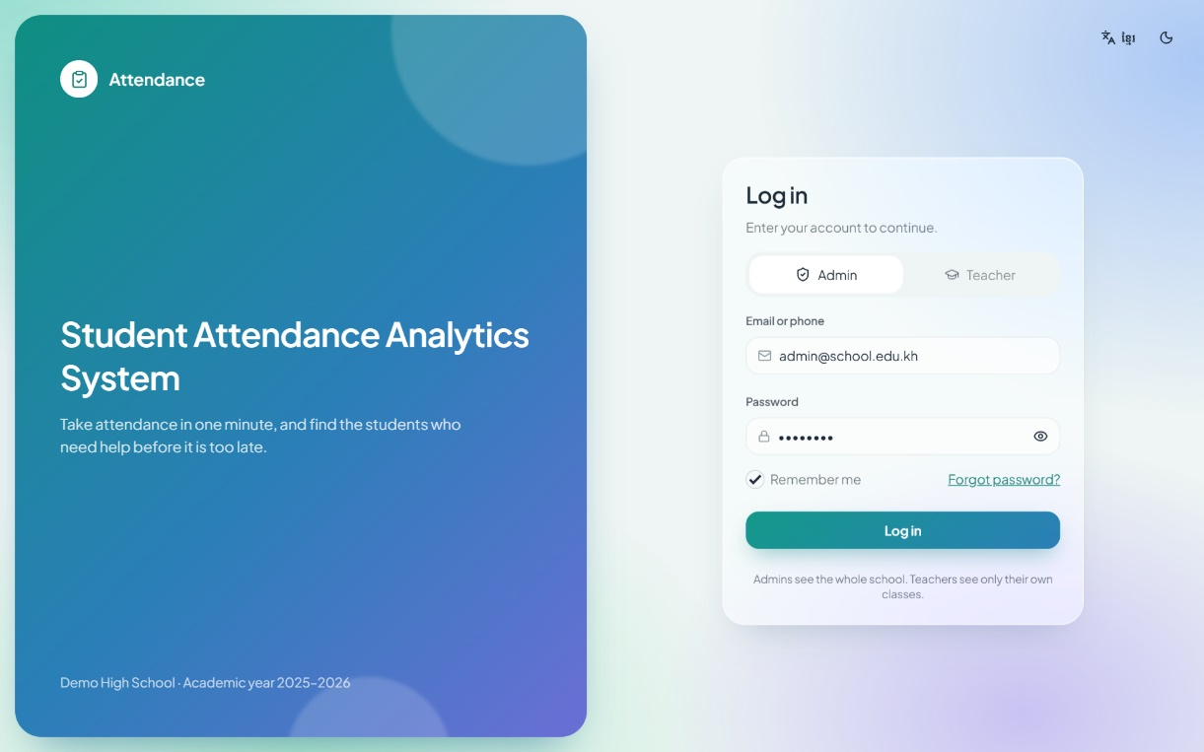
៣. លទ្ធផលស្រាវជ្រាវ
www.usea.edu.kh
៣.២ Authentication
Website (Admin + Teacher)
Choose a role: Admin or Teacher
Admin opens the school Dashboard; Teacher opens My Dashboard
Show / hide password, Remember me
Forgot password: reset link by email
Android app (Teacher)
Splash screen, then login
Same teacher account as on the website
Web login page
Knowledge. Skills .Excellence . Social
បទបង្ហាញដោយ៖ [Team member names]

Slide 15
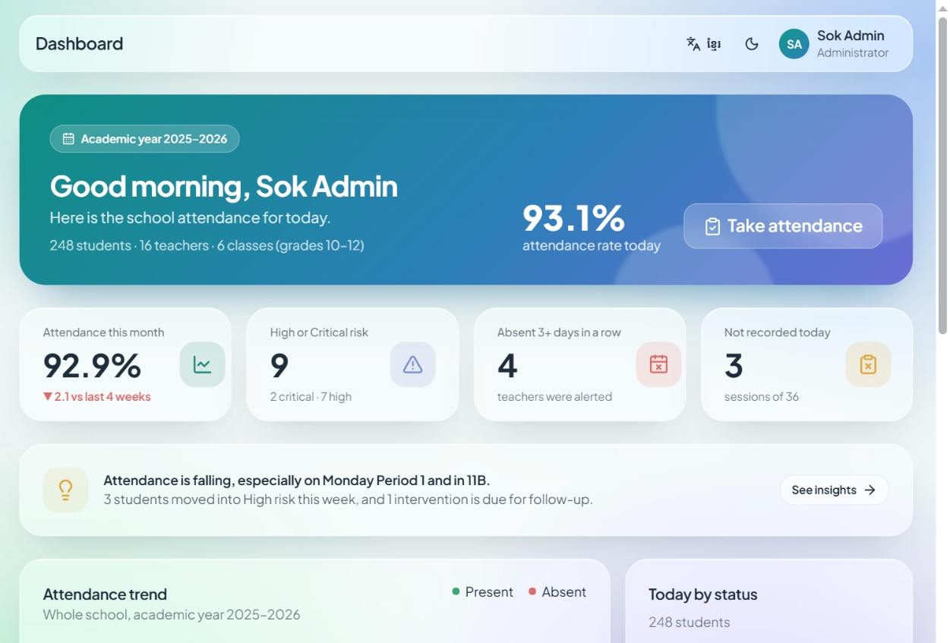
៣. លទ្ធផលស្រាវជ្រាវ
www.usea.edu.kh
៣.៣ Admin Dashboard: Meaning First
92.9%
9
4
3
This month, ▼ 2.1
High or Critical risk
Absent 3+ days in a row
Not recorded today
Every number has a meaning: a trend or a next step
Insight line: "Attendance is falling, especially Monday Period 1 and 11B"
Trend chart: Present vs. Absent by month
Rate by class and absences by weekday
Priority list with risk level and trend
Knowledge. Skills .Excellence . Social
បទបង្ហាញដោយ៖ [Team member names]
Notes:
A weak dashboard says "Attendance = 84%". Ours says "84%, down 7 points, mostly in Period 1, and 12 students moved into High risk". The four cards answer: how are we doing, who needs help, who is missing many days, and what is not recorded yet.

Slide 16
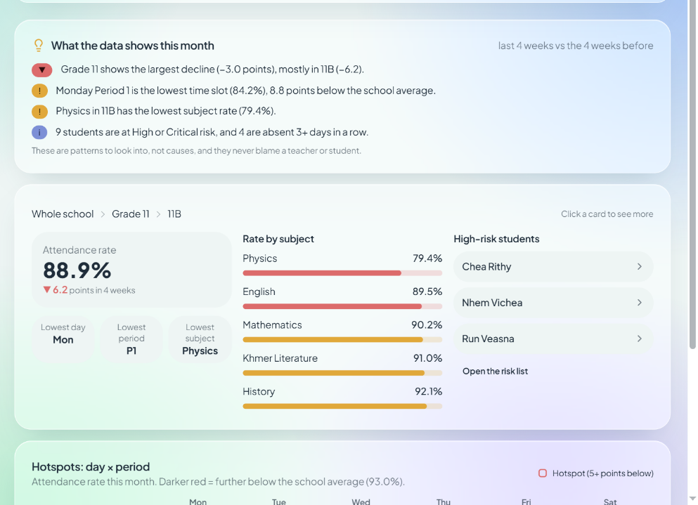
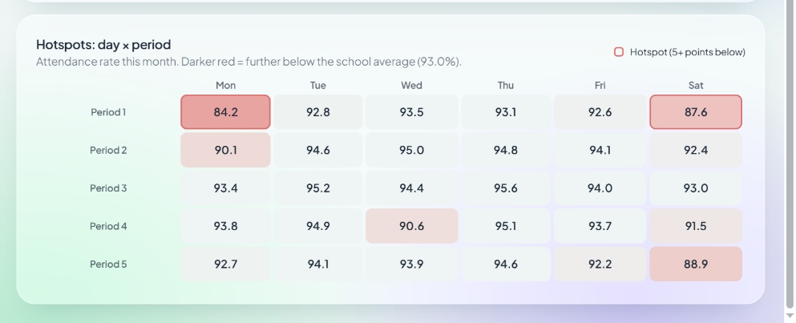
៣. លទ្ធផលស្រាវជ្រាវ
www.usea.edu.kh
៣.៤ Insights: Drill-down & Hotspots
Hotspots: day × period
Drill-down: School → Grade → Class → Student
Class view: rate and trend; lowest day, period and subject; high-risk students
Hotspots: red cells are 5+ points below the school average
Plain words: "Monday Period 1 is the lowest time slot (84.2%)"
Drill-down: Whole school → Grade 11 → 11B
Insights show patterns to look into, not causes, and they never blame a teacher or a student.
Knowledge. Skills .Excellence . Social
បទបង្ហាញដោយ៖ [Team member names]
Notes:
Is the problem one student, or the timetable? 11B looks low, but drilling down shows Physics at 79.4%, and the hotspot grid shows Monday Period 1. That changes the question from "why are students absent?" to "what happens in that period?".

Slide 17
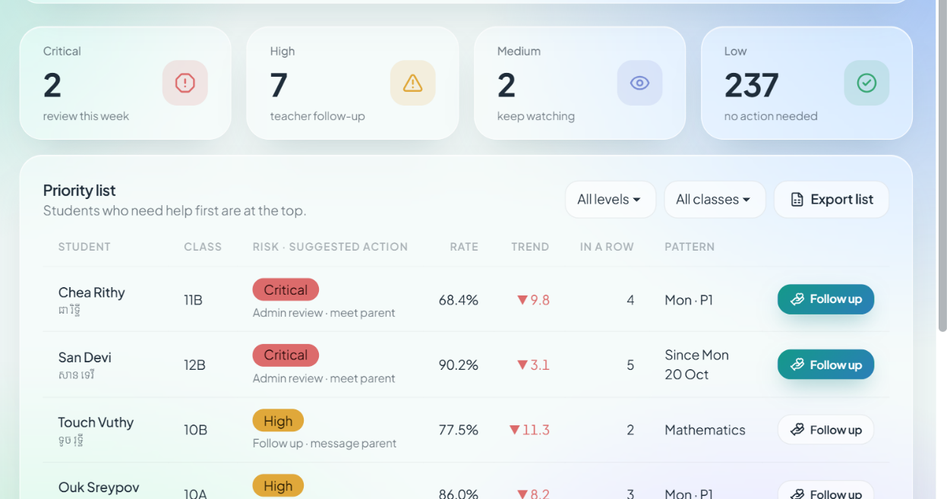
៣. លទ្ធផលស្រាវជ្រាវ
www.usea.edu.kh
៣.៥ Early Warning: Risk Levels
Level | Rule (any one)
Critical | Below 70%, or 5+ days absent in a row
High | 70–79%, 3–4 days in a row, or down 10+ points
Medium | 80–89%, down 5–9 points, or 3+ absences with no reason
Low | 90%+, stable or improving
A warning, not a prediction. The rules are simple on purpose, so anyone can explain them.
Priority list: students who need help first are at the top
Each level has a suggested action: e.g. High → follow up and message the parent
Trend = last 4 weeks vs. the 4 weeks before
Knowledge. Skills .Excellence . Social
បទបង្ហាញដោយ៖ [Team member names]
Notes:
Two students can both have 8 absences, but absences in a row and a falling trend matter more. The highest matching level is used. 9 students are High or Critical in our sample school.

Slide 18
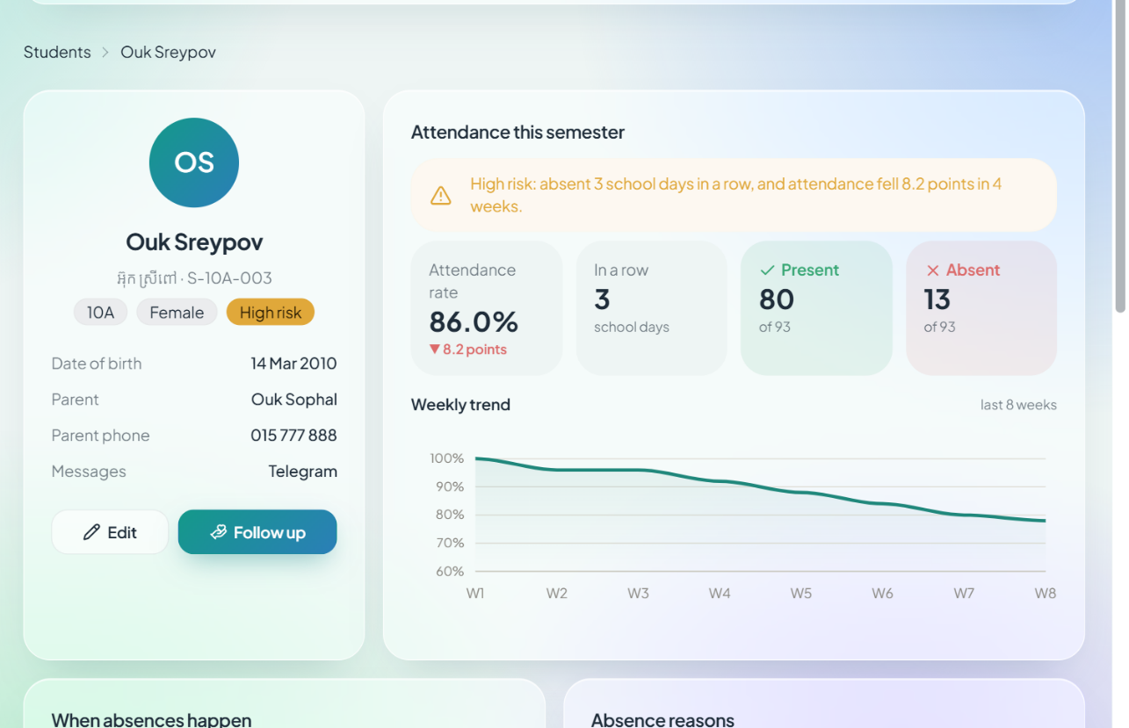
៣. លទ្ធផលស្រាវជ្រាវ
www.usea.edu.kh
៣.៦ Student Profile
Rate with trend: 86.0%, down 8.2 points
3 days in a row → High risk
When: Monday, Period 1, Mathematics
Reasons: Not given 7 · Sick 4 · Family 2
Interventions with before → after
One page answers: what is happening, when it happens, and what the school already did about it.
Knowledge. Skills .Excellence . Social
បទបង្ហាញដោយ៖ [Team member names]
Notes:
This is the Student 360 view from the plan. Clicking a student anywhere (risk list, insights, dashboard) opens this page.

Slide 19
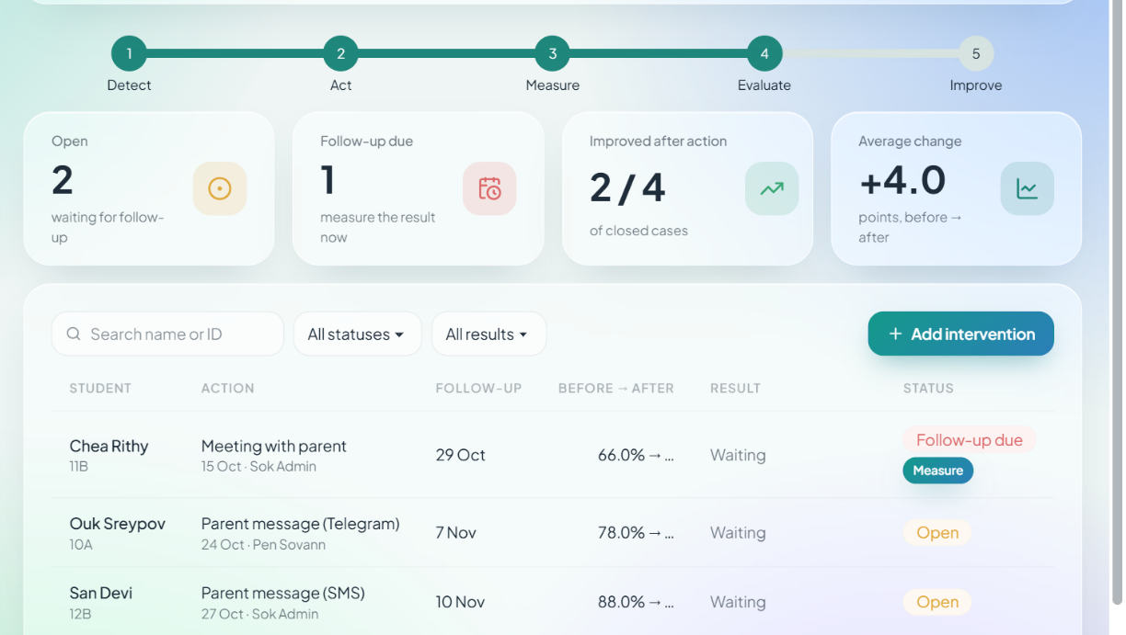
៣. លទ្ធផលស្រាវជ្រាវ
www.usea.edu.kh
៣.៧ Interventions & Parent Messages
Detect
Act
Measure
Evaluate
Improve
Each action: type, date, person, follow-up date (2 weeks)
Before → after: 10 school days on each side
Result: Improved (+5), No clear change, or Declined (−5)
Parents: Telegram alert after submit; monthly report; SMS if not on Telegram
Before/after shows a change, not proof that the action caused it. So we write "after the intervention", not "because of it".
Knowledge. Skills .Excellence . Social
បទបង្ហាញដោយ៖ [Team member names]
Notes:
This closes the loop that ordinary attendance systems miss: detect, act, measure, evaluate, improve. Touch Vuthy improved from 70% to 82.5% after a phone call; Run Veasna declined after counselling, so the school should try something else.

Slide 20
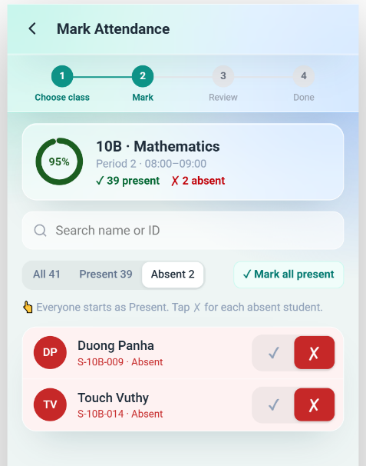
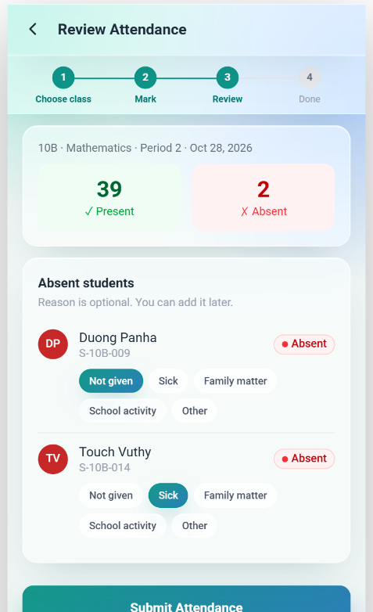
៣. លទ្ធផលស្រាវជ្រាវ
www.usea.edu.kh
៣.៨ Mark Attendance Flow
1 Choose class
2 Mark
3 Review
4 Done
Choose class: today's timetable; the next class is highlighted
Mark: everyone starts as Present; tap ✗ for each absent student (one row each, with Undo)
Tools: Mark all present, search, All / Present / Absent filter, live %
Review: Present 39 · Absent 2, with an optional reason for each absent student
Done: notify parents on Telegram, then go to the next class
Knowledge. Skills .Excellence . Social
បទបង្ហាញដោយ៖ [Team member names]
Notes:
This is the most important flow, because good analytics needs complete data. In a class of 41 with 2 absences, the teacher needs about 4 taps. The system loads the right student list from the timetable, so the teacher never chooses students by hand.

Slide 21
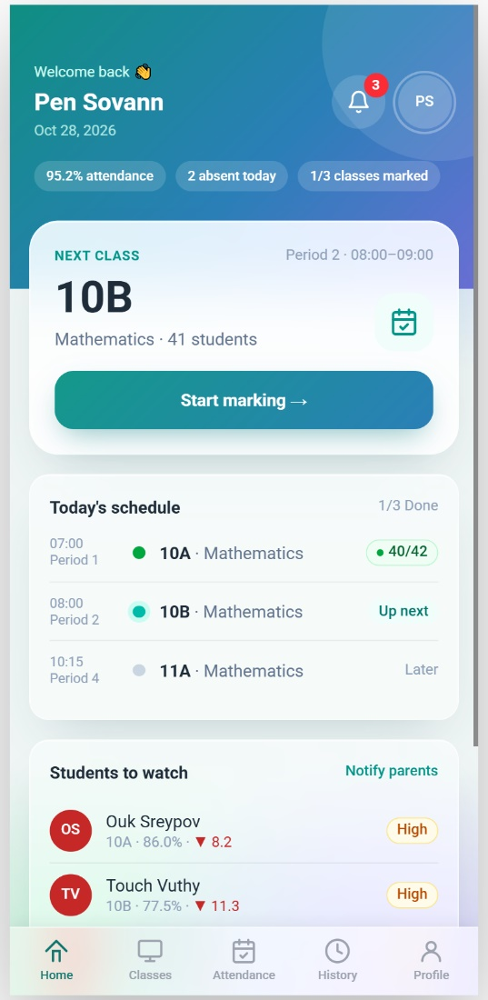
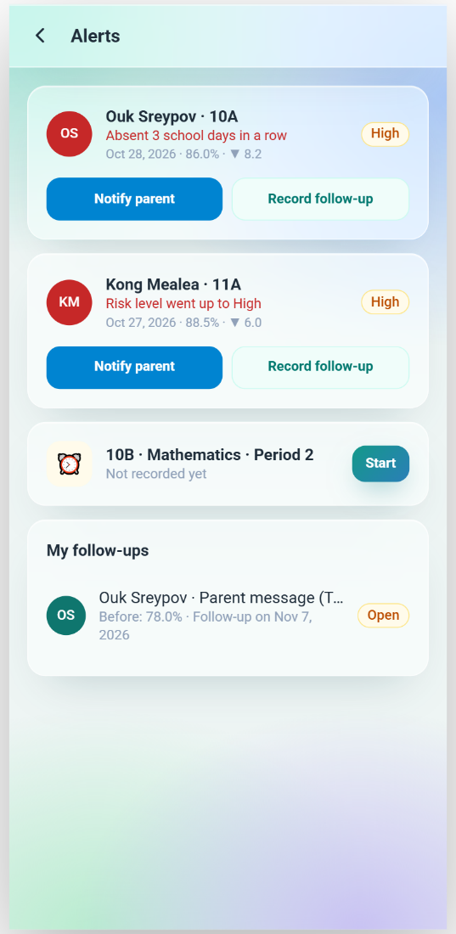
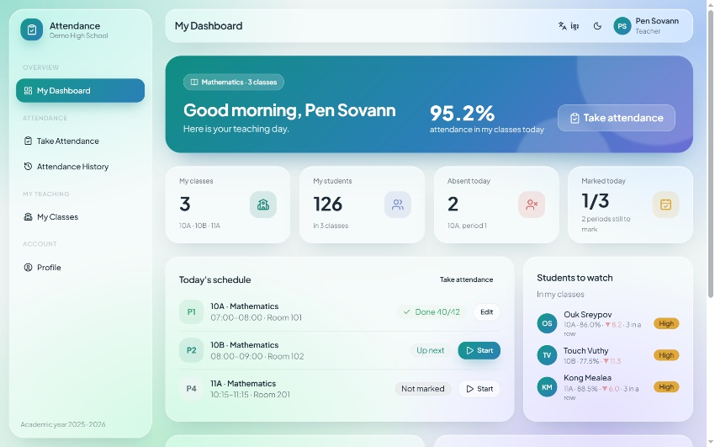
៣. លទ្ធផលស្រាវជ្រាវ
www.usea.edu.kh
៣.៩ Teacher: Android App & Website
Website: My Dashboard (teacher view)
One account, same numbers
Next class first
Alerts: 3 days in a row, risk up, not recorded
Record a follow-up in 2 taps
Only their own classes
Android app: Home and Alerts
Knowledge. Skills .Excellence . Social
បទបង្ហាញដោយ៖ [Team member names]
Notes:
Both show 95.2% attendance, 2 absent today, and the same three students to watch. The bell on the app shows alerts; the teacher can notify the parent or record a follow-up, which then appears on the website under Interventions.

Slide 22
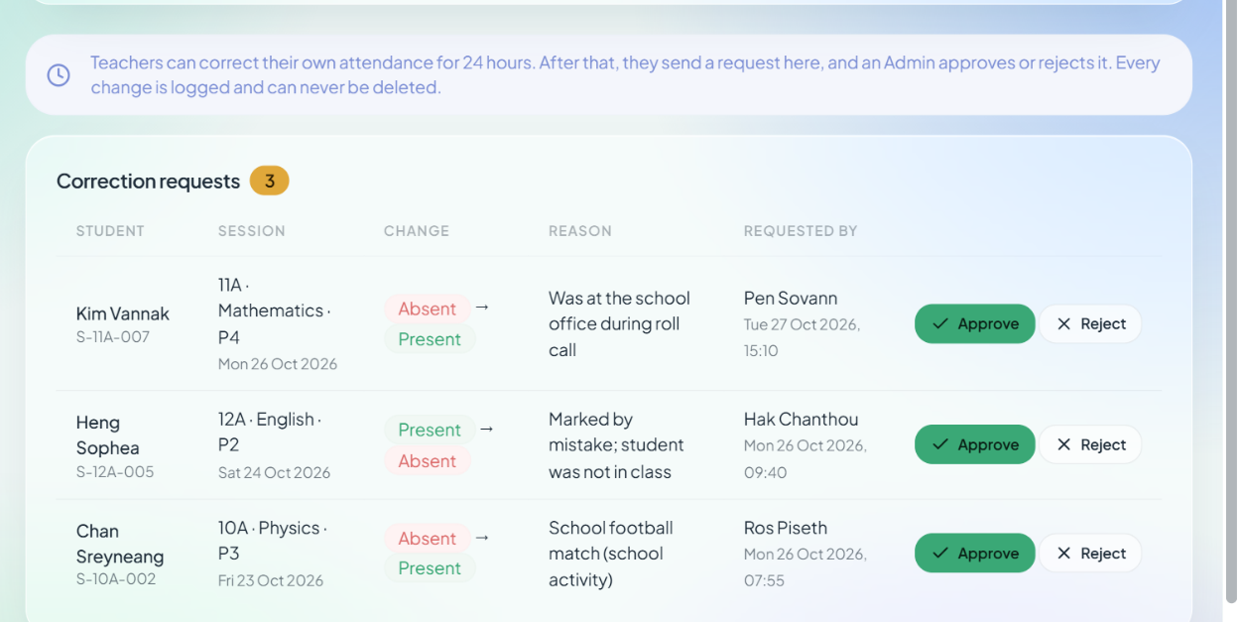
៣. លទ្ធផលស្រាវជ្រាវ
www.usea.edu.kh
៣.១០ Trustworthy Data: Corrections & Audit Log
24-hour rule: teachers correct their own records for 24 hours
After that: a correction request; the Admin approves or rejects
Audit log: who, when, old → new, reason; never deleted
Drafts are never counted in any rate
Complete roster: a session is submitted only when every student has a record
The backend checks these rules on every request; hiding a button is not enough.
Knowledge. Skills .Excellence . Social
បទបង្ហាញដោយ៖ [Team member names]
Notes:
Analytics are only as good as the data. These rules stop silent changes and make every correction traceable.

Slide 23
៣. លទ្ធផលស្រាវជ្រាវ
www.usea.edu.kh
៣.១១ Database Design (PostgreSQL)
Group | Tables | Purpose
Access | roles, users, teachers | Login and permissions
School structure | academic_years, classes, subjects, students, guardians, student_guardians | School data and parent contacts
Assignments | student_enrollments, teaching_assignments, schedules | Who studies and teaches what, and when
Attendance | attendance_sessions, attendance_records, absence_reasons | Recording
Analytics & action | risk_snapshots, alerts, interventions, notifications | Early warning and follow-up
Accountability | correction_requests, audit_logs | Corrections and change history
Key idea: a Session is one lesson on one date; a Record is one student's Present/Absent in it. Rules: one record per student per session; only Present/Absent; a reason only when Absent.
Knowledge. Skills .Excellence . Social
បទបង្ហាញដោយ៖ [Team member names]
Notes:
One shared database for the app and the website. Separating sessions from records lets us calculate rates and history correctly. Triggers block late changes and write the audit log automatically.

Slide 24
៣. លទ្ធផលស្រាវជ្រាវ
www.usea.edu.kh
៣.១២ Management Modules (Web)
Module | Capabilities
Students | Search, filter by class and gender, add, edit, delete, import from Excel, profile page
Teachers | Search, add, edit, delete, details page with their classes and recent sessions
Classes | One card per class: add, edit, delete, homeroom teacher, room, attendance rate
Subjects | Code, English and Khmer name, hours per week
Parents | Contacts for Telegram and SMS messages, linked to their children
Teaching Assignments | Who teaches which subject in which class
Confirm before every delete
Inline validation messages
"Saved successfully" message
✓
✓
✓
Knowledge. Skills .Excellence . Social
បទបង្ហាញដោយ៖ [Team member names]

Slide 25
៣. ការវិភាគចំណុចខ្លាំង និងចំណុចខ្សោយ
www.usea.edu.kh
៣.១៣ Challenges & Solutions
Challenge | Solution
Turning data into insight | Trends, risk levels, hotspots and plain-word insights
Finding at-risk students early | Clear risk rules and alerts for absences in a row
Knowing if an action worked | Interventions with before → after results
Marking 40+ students quickly | Everyone starts as Present; one row per student; Undo
Keeping data trustworthy | 24-hour rule, correction requests, audit log
Khmer and English everywhere | One translation file, including charts
Result: a class of 41 with 2 absences is marked in about 4 taps, and the school sees who needs help first.
Knowledge. Skills .Excellence . Social
បទបង្ហាញដោយ៖ [Team member names]

Slide 26
៣. ការវិភាគចំណុចខ្លាំង និងចំណុចខ្សោយ
www.usea.edu.kh
៣.១៤ Strengths & Weaknesses
✓
ចំណុចខ្លាំង (Strengths)
!
ចំណុចខ្សោយ (Weaknesses)
Analytics, not just recording: trends, risk, hotspots
Early warning with clear, explainable rules
Actions measured before and after
Fast marking with optional reasons
English and Khmer, light and dark, phone-friendly
No backend yet: the website and app use sample data
Telegram, SMS and exports are design only
Risk thresholds must be checked with real data
The Android app is still a Figma Make prototype
No real login or security yet
Knowledge. Skills .Excellence . Social
បទបង្ហាញដោយ៖ [Team member names]

Slide 27
៤. សេចក្តីសន្និដ្ឋាន
www.usea.edu.kh
៤.១ Conclusion & Next Steps
Next 12 weeks
Conclusion
Weeks 1–2: PostgreSQL database and seed data
A two-role attendance analytics system for our high school
Teachers collect complete data fast; admins see patterns, risk and results
From recording to Detect → Act → Measure
English and Khmer, one design on app and website
1
Weeks 3–4: Laravel API, login, 2 roles
2
Weeks 5–6: Real recording + 24-hour rule
3
Weeks 7–8: Analytics queries, live dashboards
4
Weeks 9–10: Alerts, interventions, Telegram / SMS
5
Weeks 11–12: Testing with realistic data
6
Knowledge. Skills .Excellence . Social
បទបង្ហាញដោយ៖ [Team member names]
Notes:
Next we follow the plan: database first, then the shared backend, then connect the app and website to real data. Later: offline mode, QR check-in and push notifications.

Slide 28
៥. DEMO
www.usea.edu.kh
៥.១ Live Demo Walkthrough
1
Web — Admin
Dashboard (meaning first) → Insights: Grade 11 → 11B → hotspots
2
Web — Early warning
At-Risk list → Student profile → Interventions (before → after)
3
Web — Trustworthy data
Corrections: approve a request → see it in the audit log
4
Web — Teacher
Log in as Teacher → My Dashboard → Take Attendance with a reason
5
Android — Teacher
Home → Alerts → Mark → Review (reason) → Notify parents → Dark mode
[Link to the website] · [Link / QR code to the Android prototype]
Knowledge. Skills .Excellence . Social
បទបង្ហាញដោយ៖ [Team member names]

